Slide 1
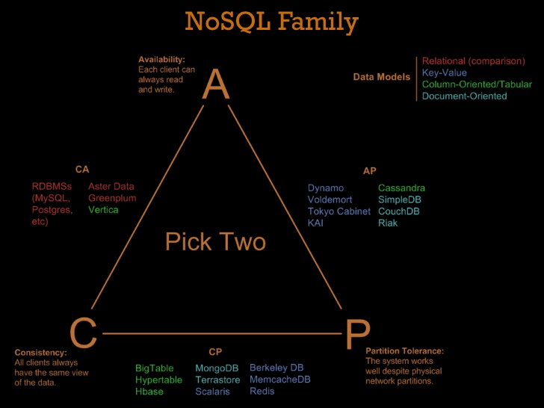
The Pilot Of HBase
2017.5
XenRon

Slide 2
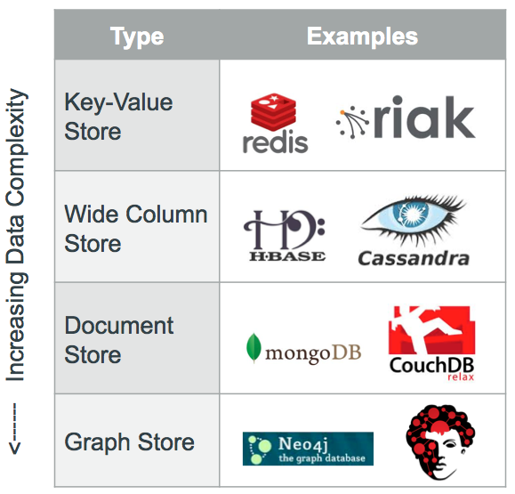
CONTENTS
01
05
NoSQL
Use Case
02
06
HBase Architecture
Quick Start
03
Hbase Basic
04
HBase Environment

Slide 3
Review
Review

Slide 4
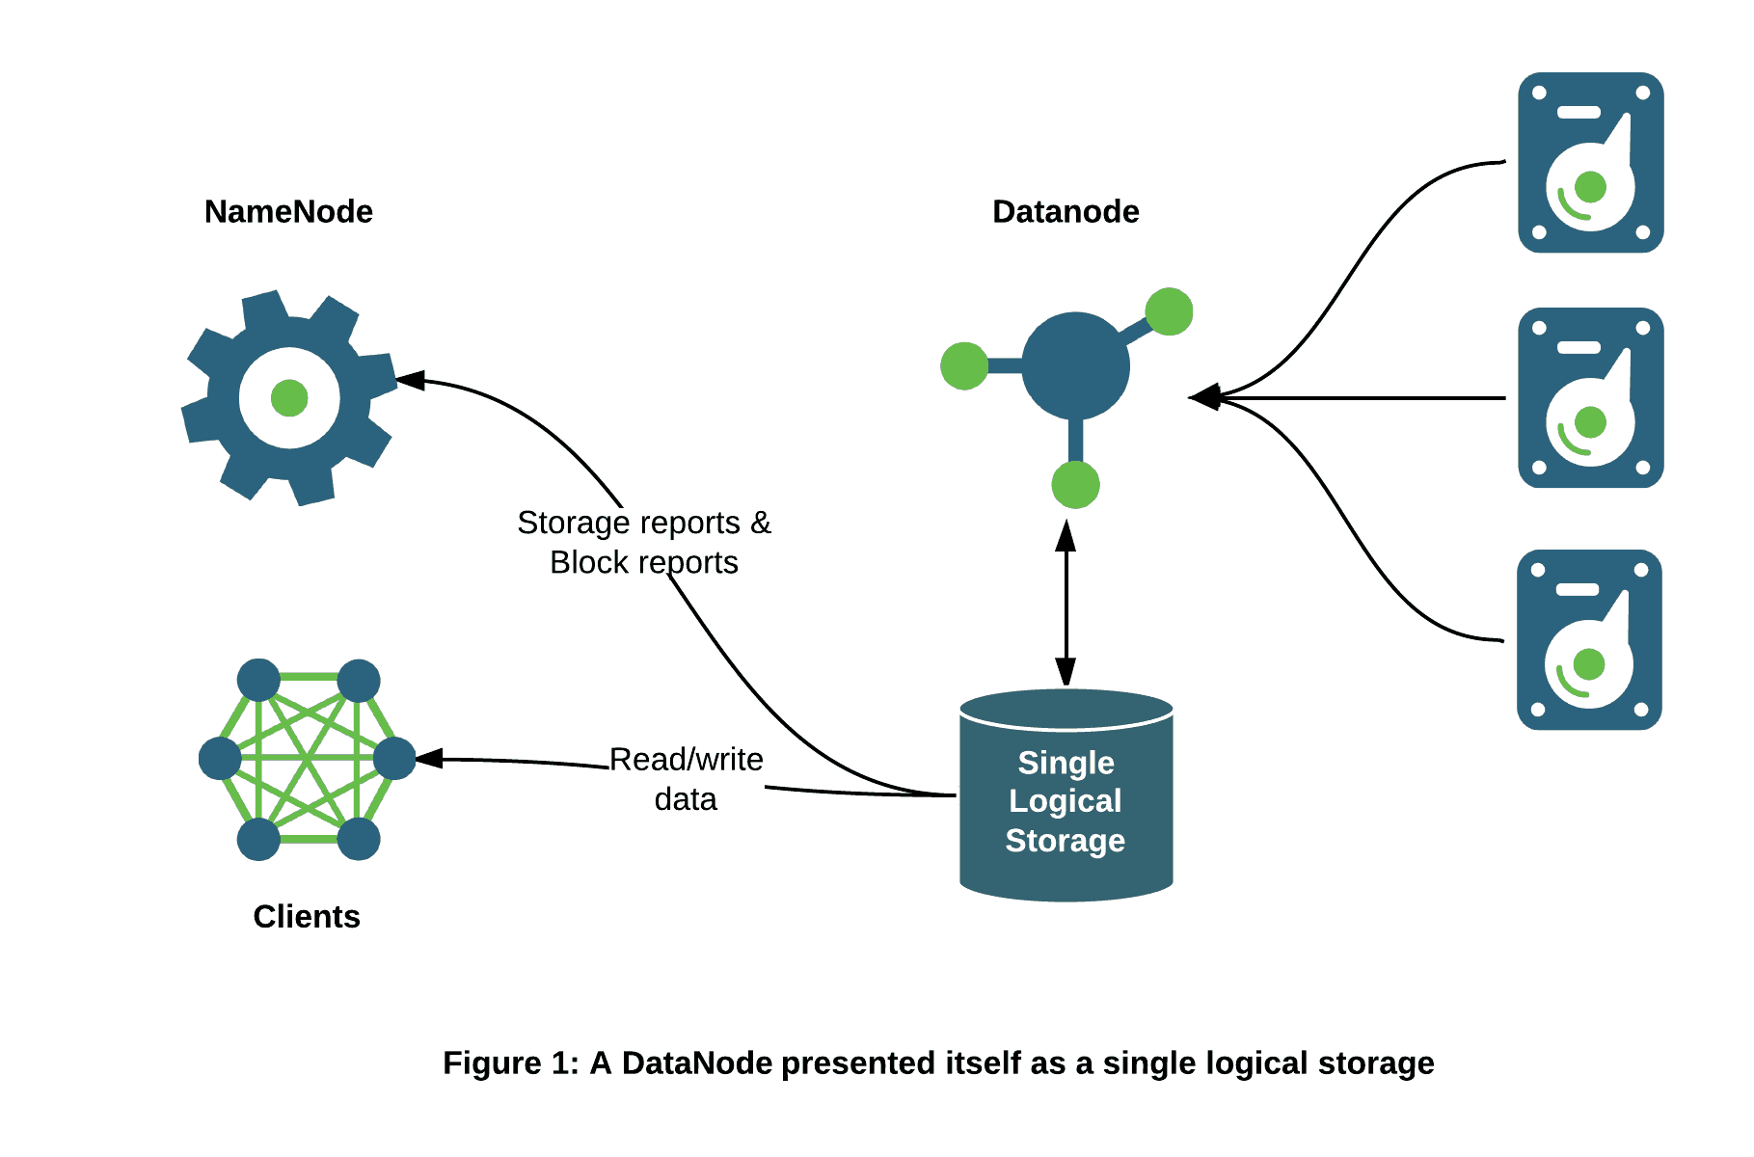
Review

Slide 5
HDFS

Slide 6
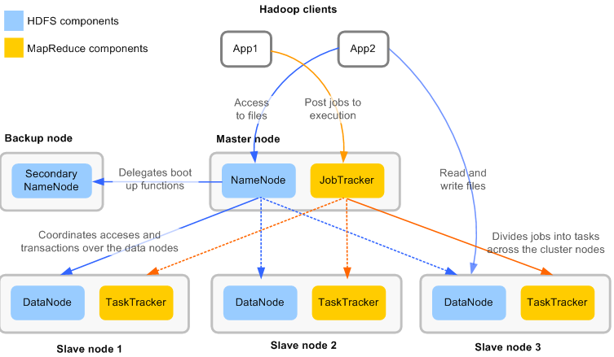
Map Reduce

Slide 7
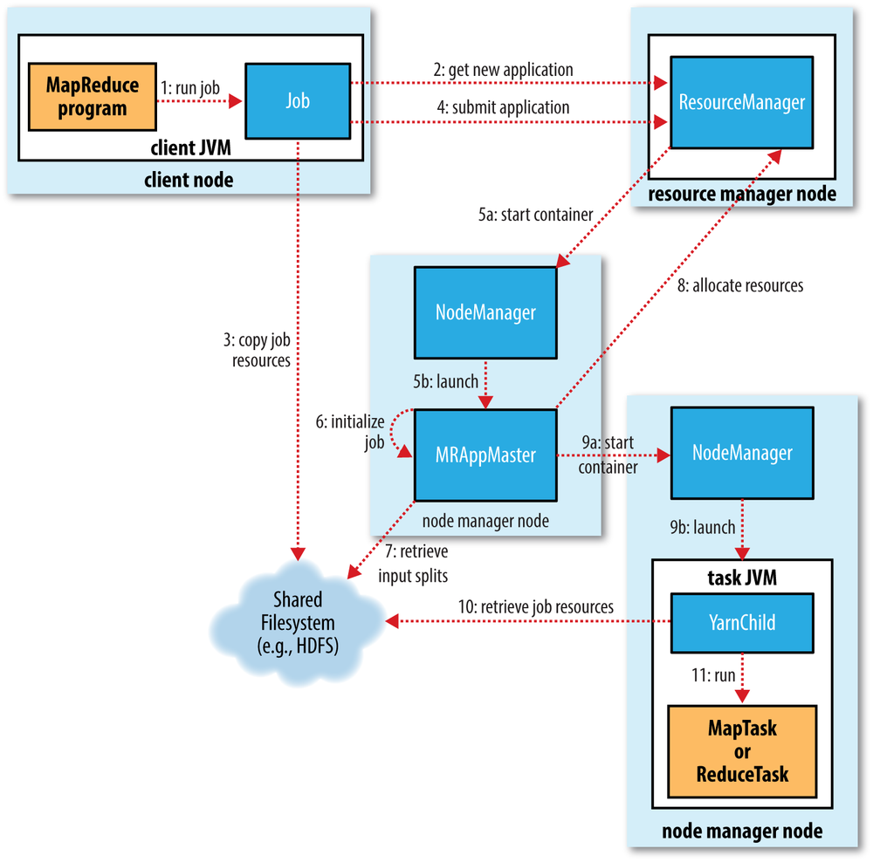
Map Reduce
Hadoop 2.x
Hadoop 1.x

Slide 8
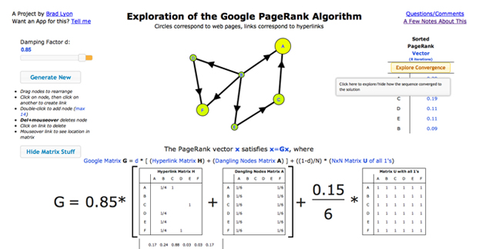
Map Reduce Model #1
Iterator Map-Reduce

Slide 9
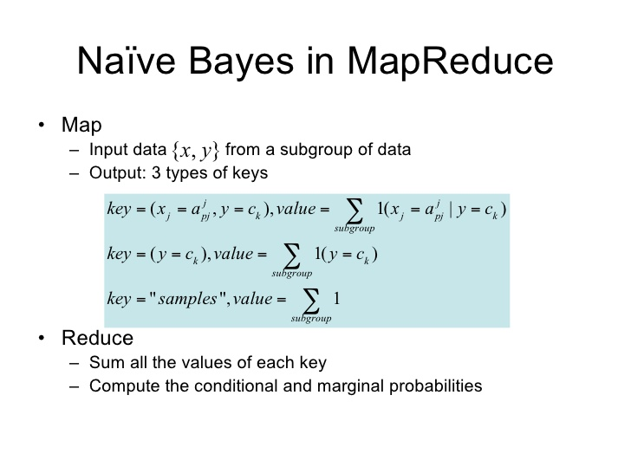
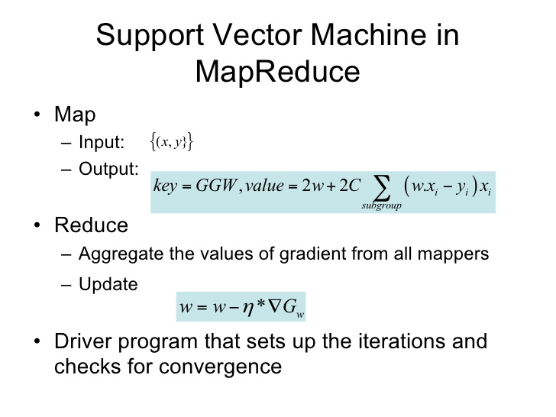
Map Reduce Model #2
Job Control

Slide 10
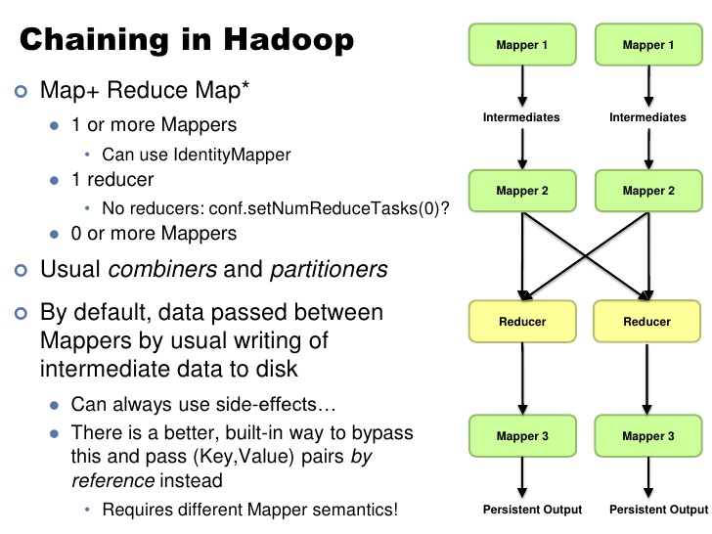
Map Reduce Model #3
Chain-Mapper Chain-Reduce

Slide 11
PART1
NoSQL

Slide 12
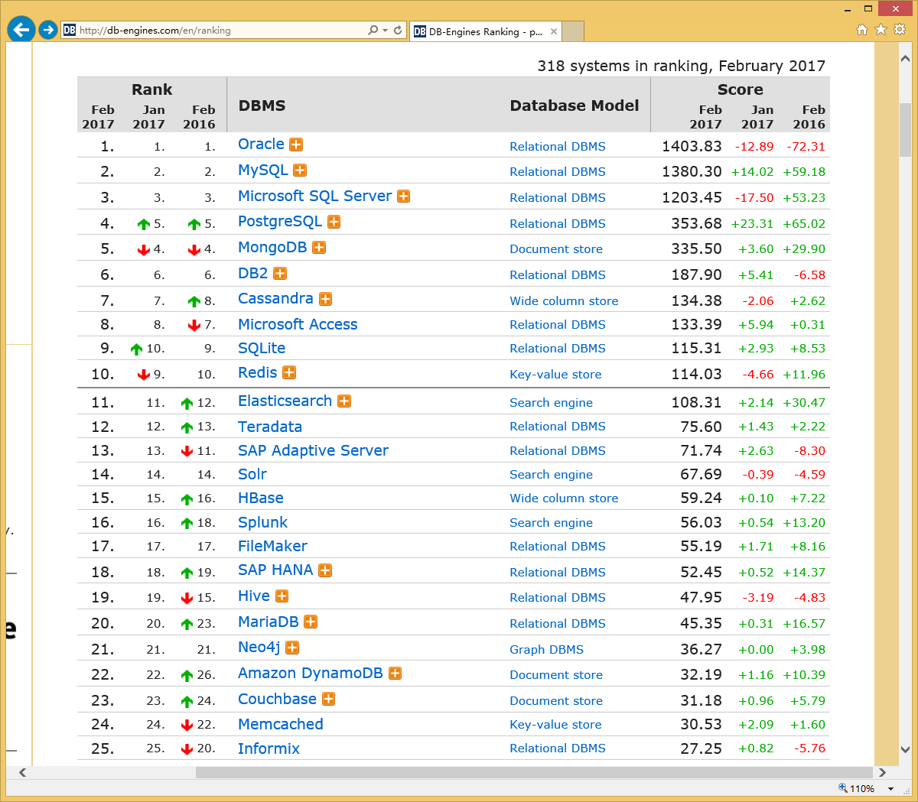
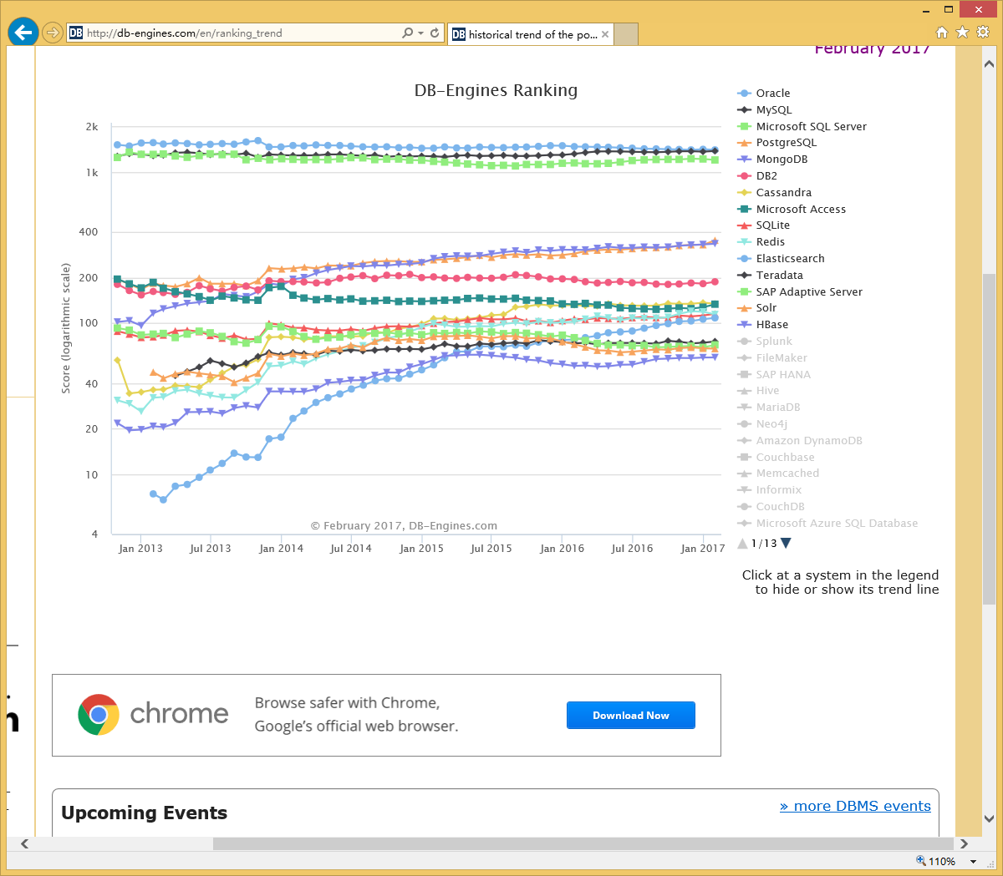
DB-Engines Ranking
http://db-engines.com/en/ranking
http://db-engines.com/en/ranking_trend

Slide 13
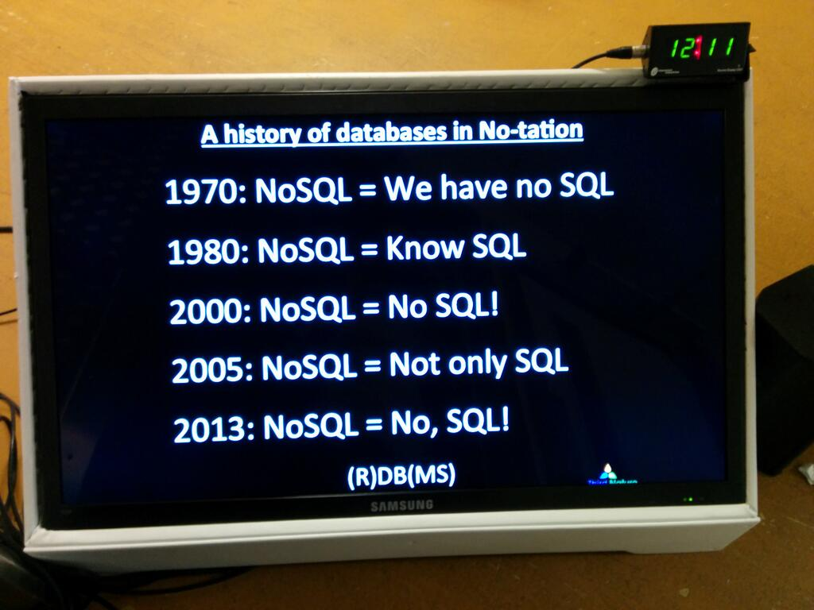
The History of SQL

Slide 14
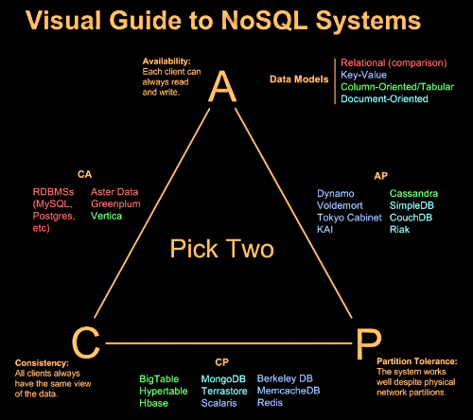
CAP Theorem
Professor Eric A. Brewer
University of California at Berkeley

Slide 15
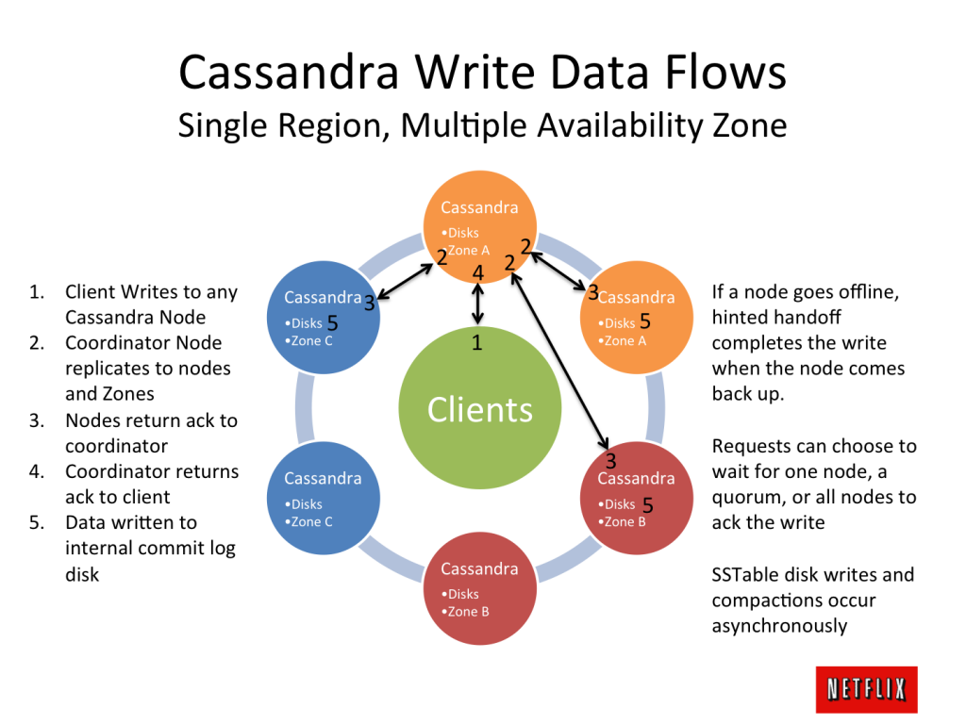
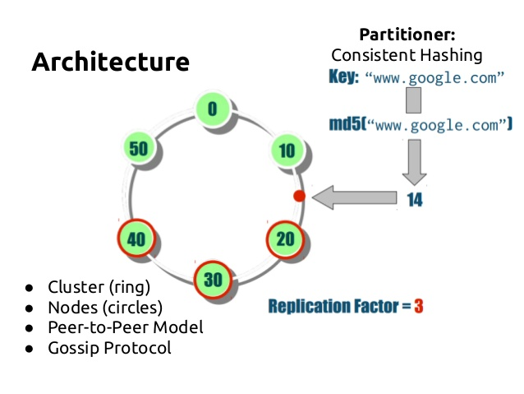
Cassandra

Slide 16

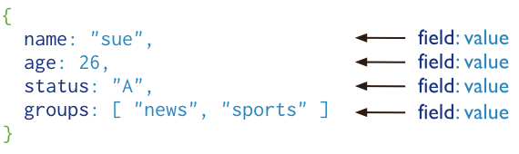
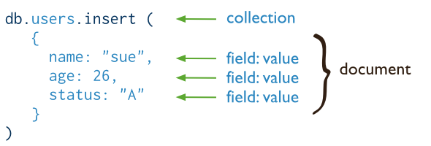
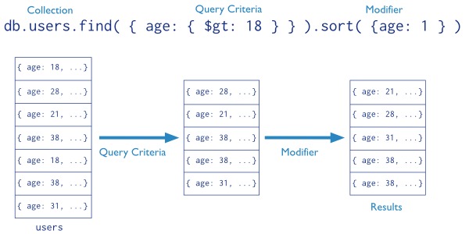
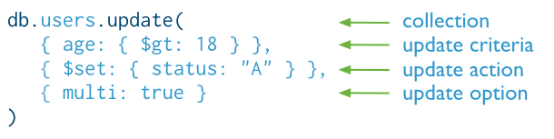
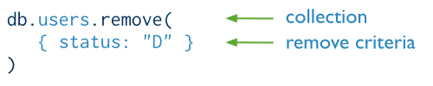
MongoDB
Official Website : https://www.mongodb.org/
The latest stable Release : v3.0.4

Slide 17
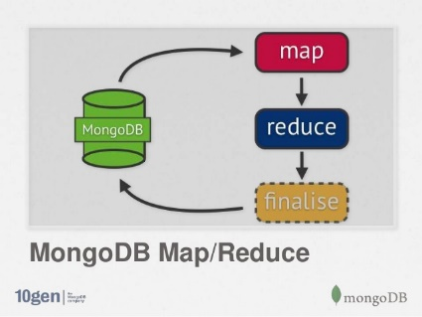
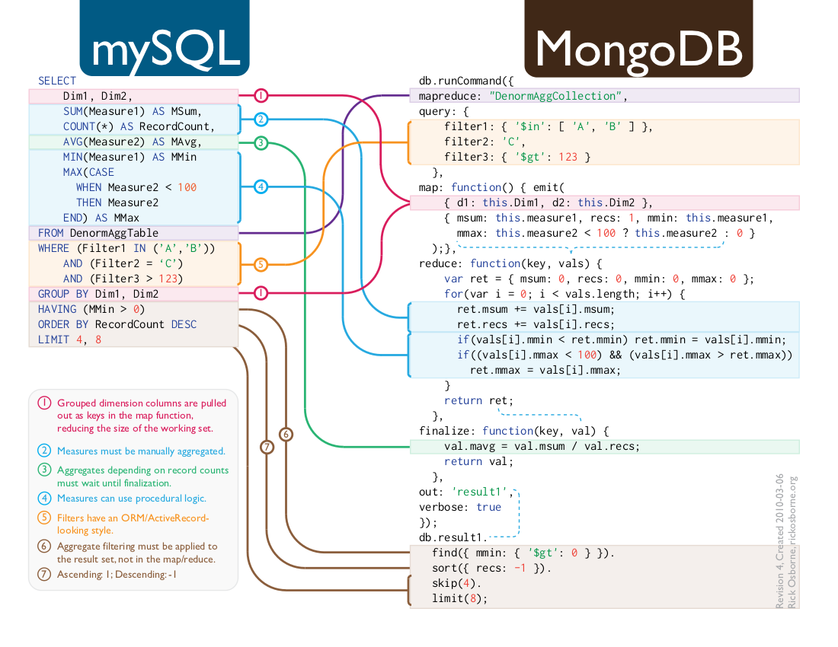
MongoDB

Slide 18
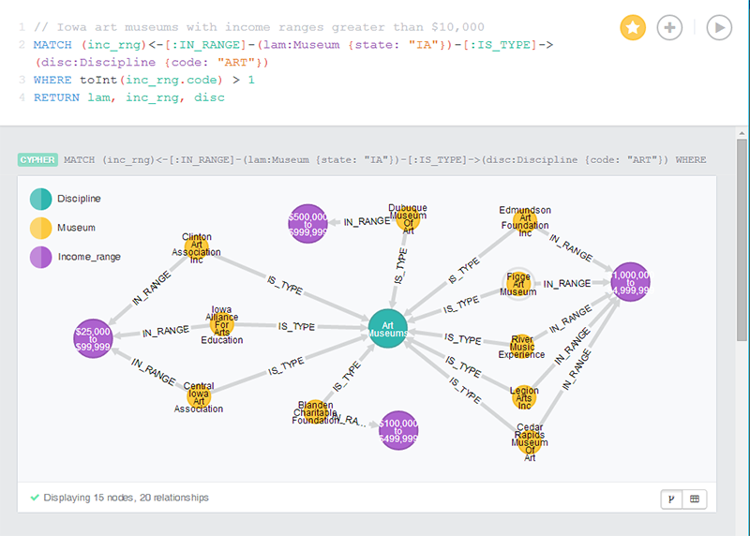
Neo4j
http://neo4j.com/docs/stable/cypher-query-lang.html
Notes:
Neo4j-Twitter-Graph-Visualization

Slide 19
PART2
Hbase Architecture

Slide 20
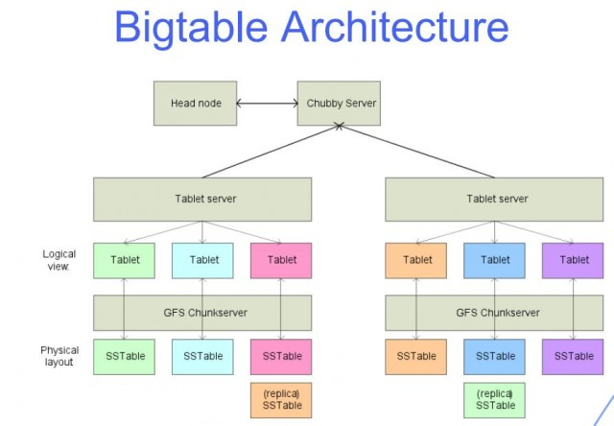
BigTable
https://research.google.com/archive/bigtable.html

Slide 21
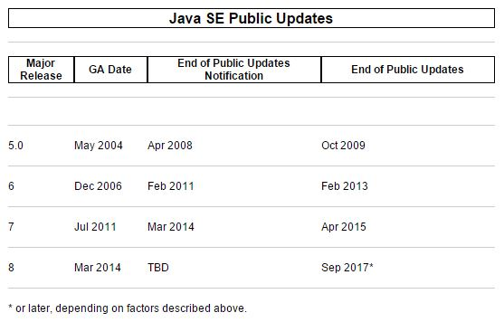

Java
http://www.oracle.com/technetwork/java/eol-135779.html

Slide 22
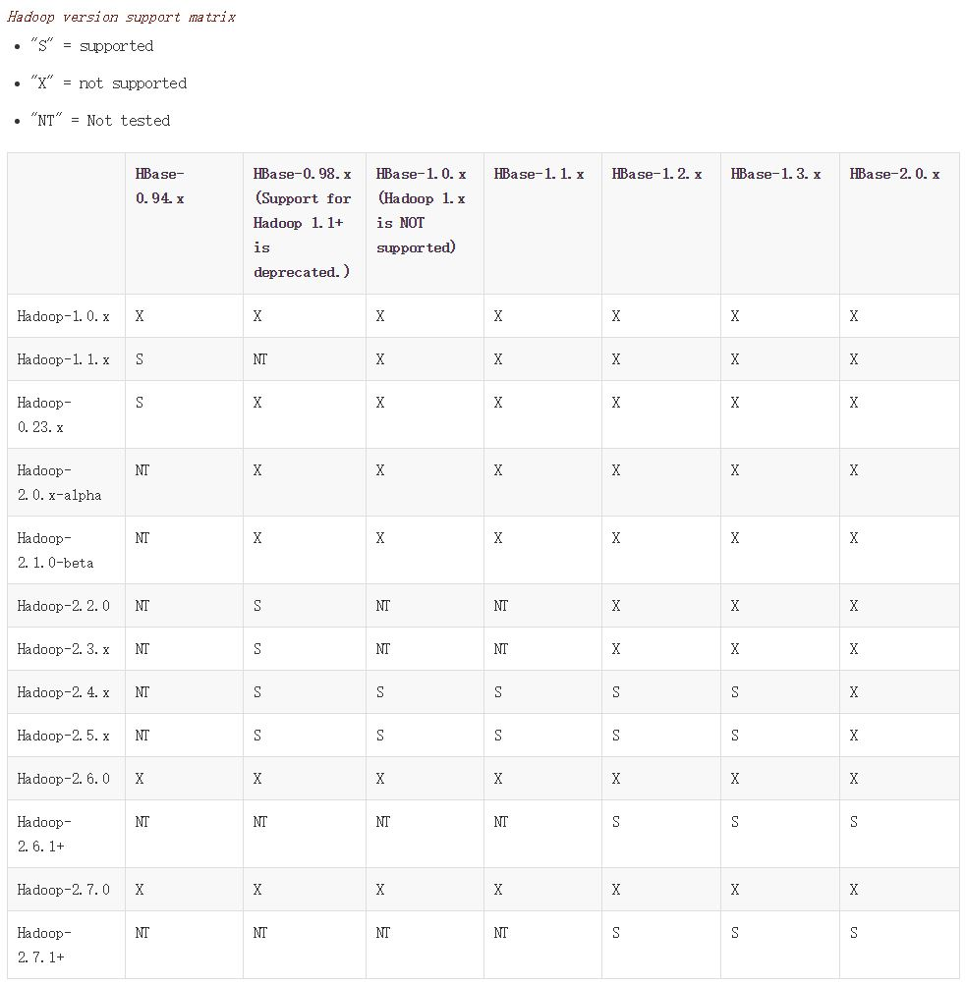
HBase Versions
https://hbase.apache.org/book.html#hadoop

Slide 23
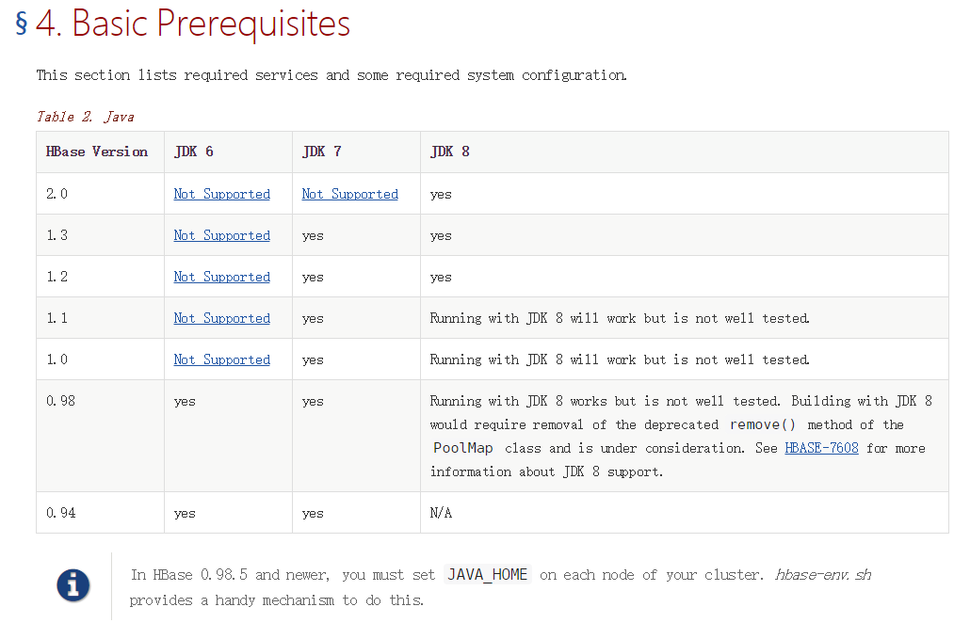
HBase Versions
https://hbase.apache.org/book.html

Slide 24
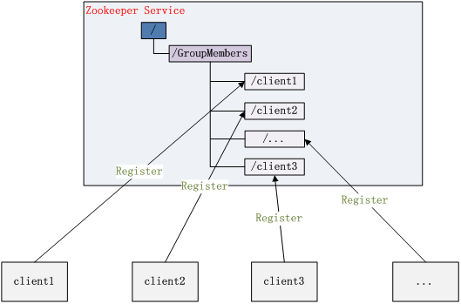
architecture

Slide 25
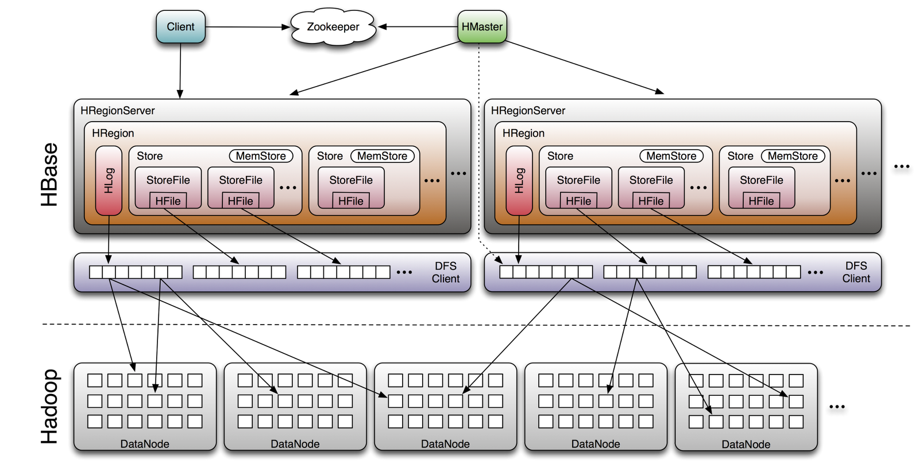
architecture

Slide 26
architecture

Slide 27
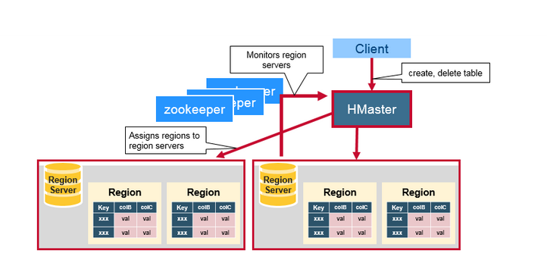
architecture

Slide 28
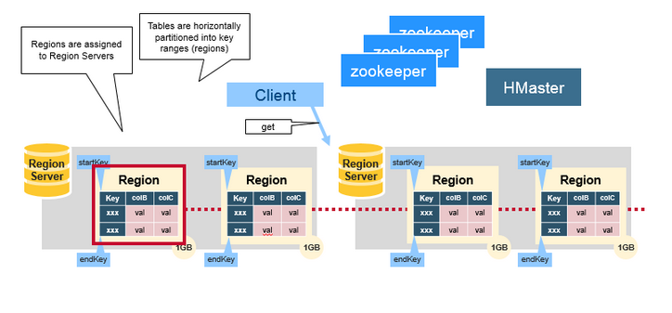
architecture

Slide 29
PART3
HBase Basic

Slide 30
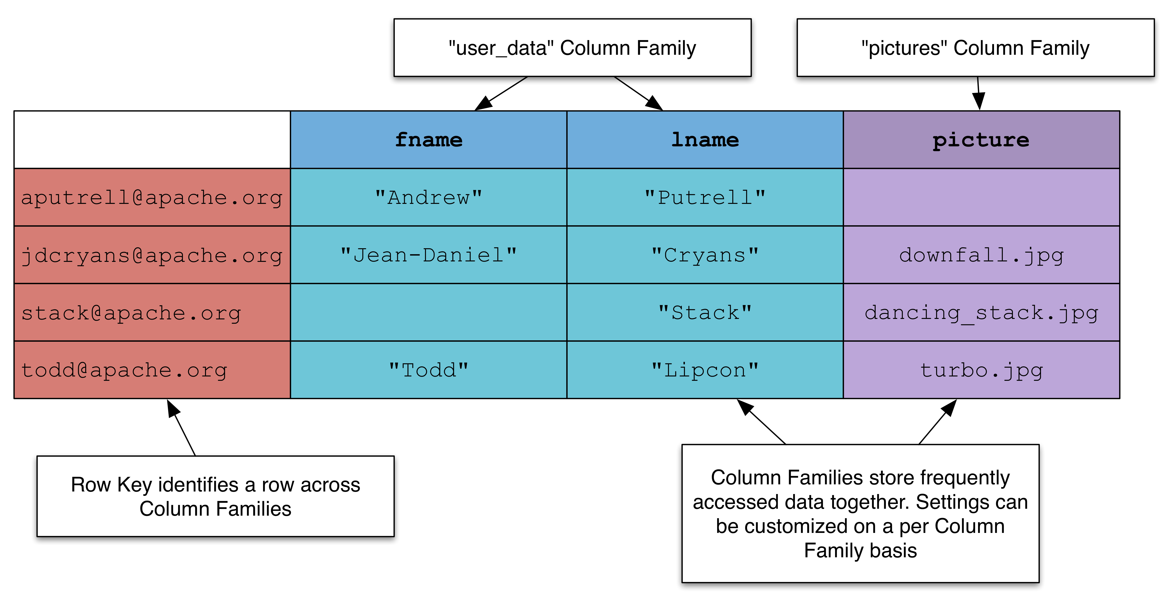
Column Family

Slide 31
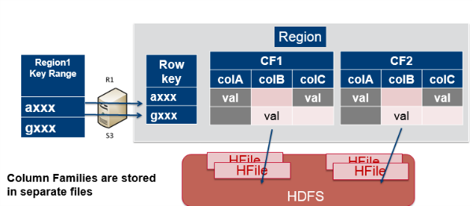
Column Family

Slide 32
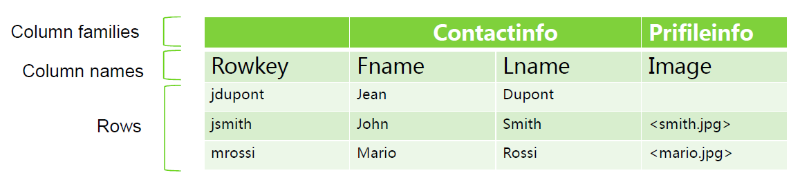
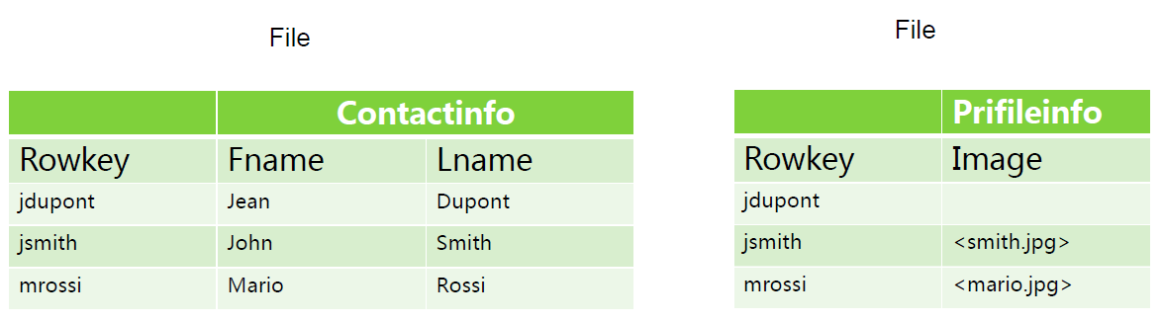
Column Family

Slide 33
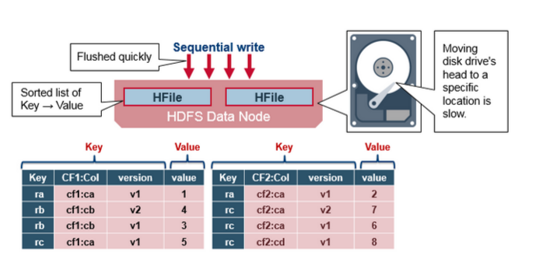
Table
Rowkey + column + timestamp -> value

Slide 34
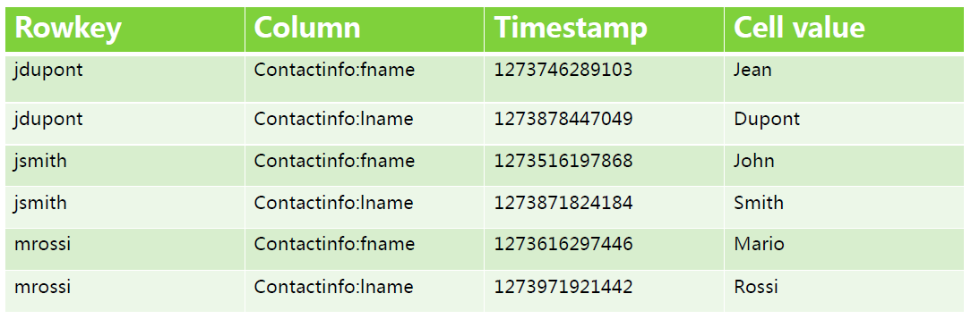
Table
Rowkey + column + timestamp -> value

Slide 35
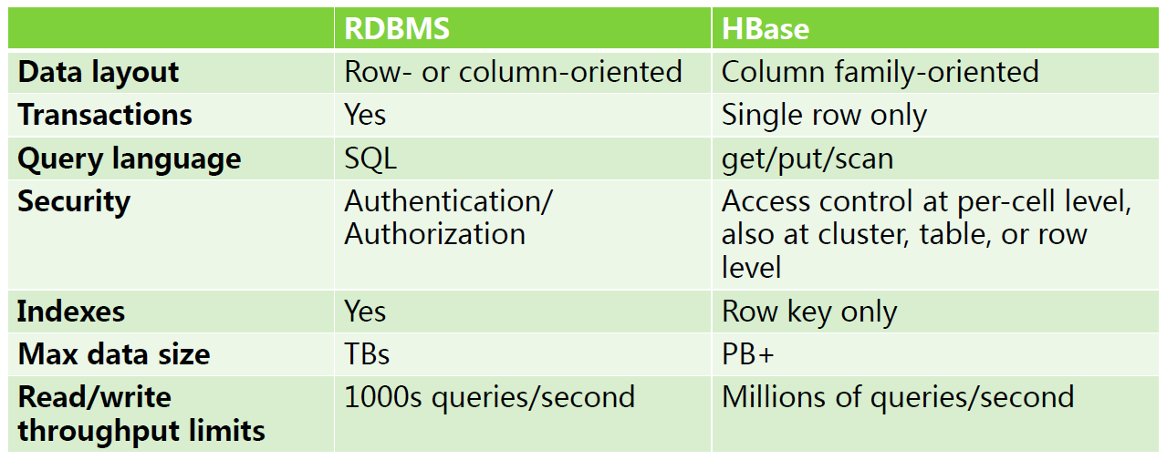
RDBMS VS HBase

Slide 36
HBase
General HBase shell commands
status
Show cluster status. Can be ‘summary’, ‘simple’, or ‘detailed’. The
default is ‘summary’.
hbase> status
hbase> status ‘simple’
hbase> status ‘summary’
hbase> status ‘detailed’
version
Output this HBase versionUsage:
hbase> version
whoami
Show the current hbase user.Usage:
hbase> whoami

Slide 37
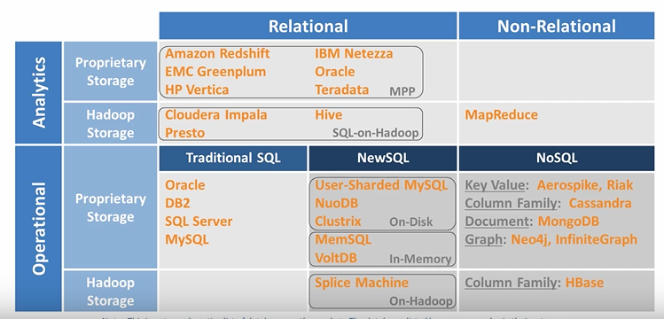
RDBMS VS NoSQL

Slide 38
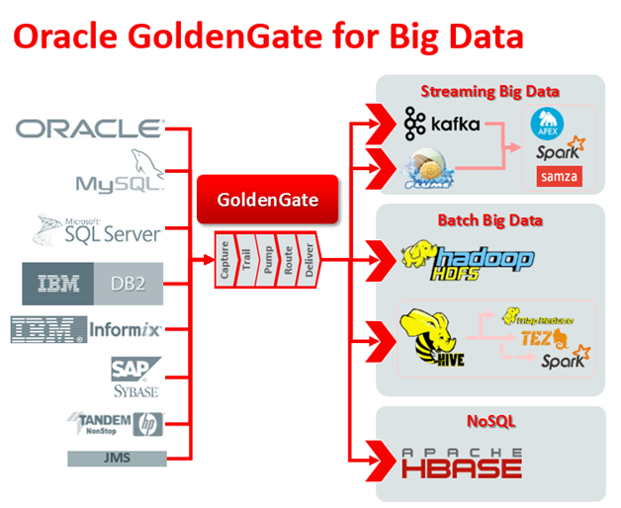
Disparate Data Sources

Slide 39
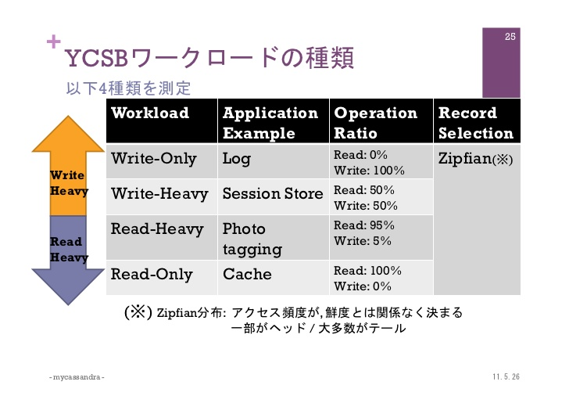
Write Heavy VS Read Heavy

Slide 40
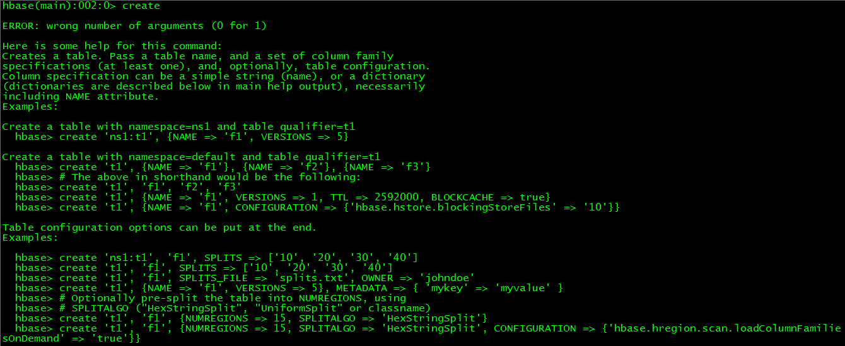
Hbase Shell
https://hbase.apache.org/book.html#shell

Slide 41
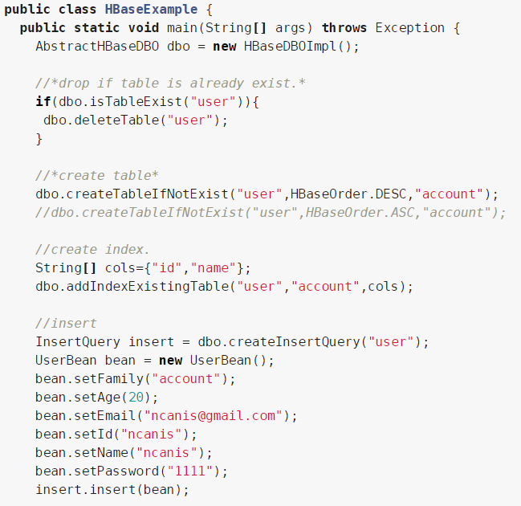
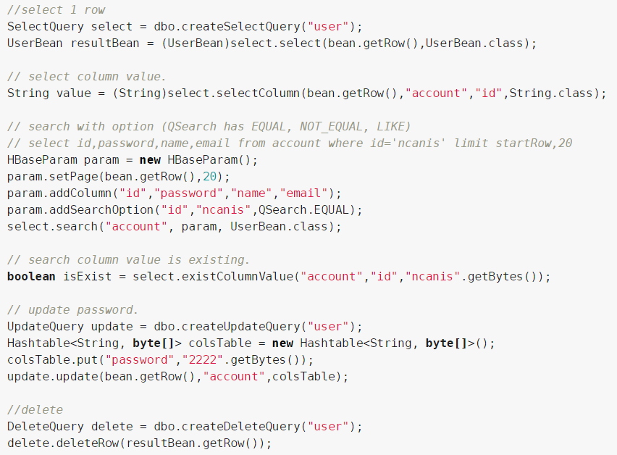
Java API
https://hbase.apache.org/book.html#jdo
https://hbase.apache.org/apidocs/index.html

Slide 42
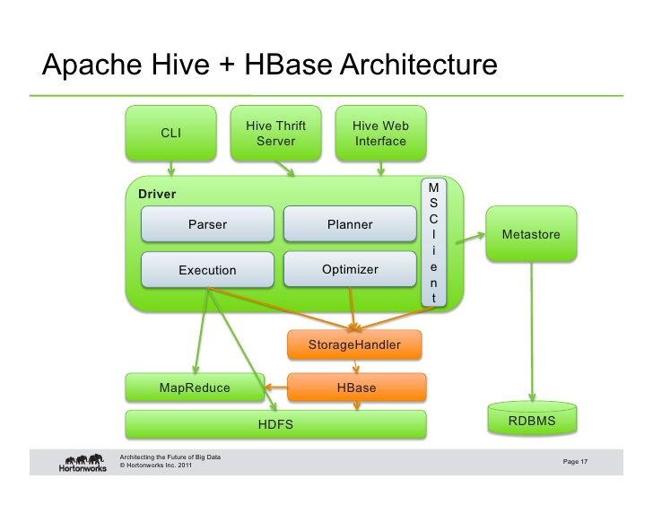
Thrift / RESTful

Slide 43
PART4
HBase Environment

Slide 44
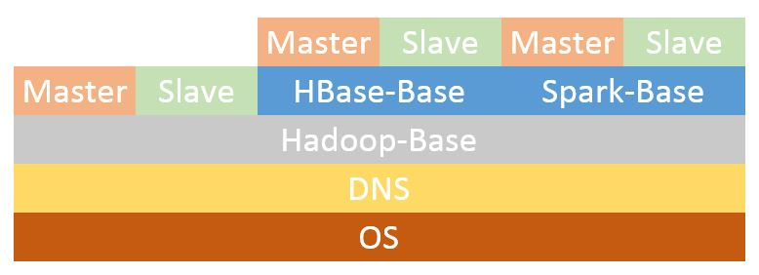
Docker

Slide 45
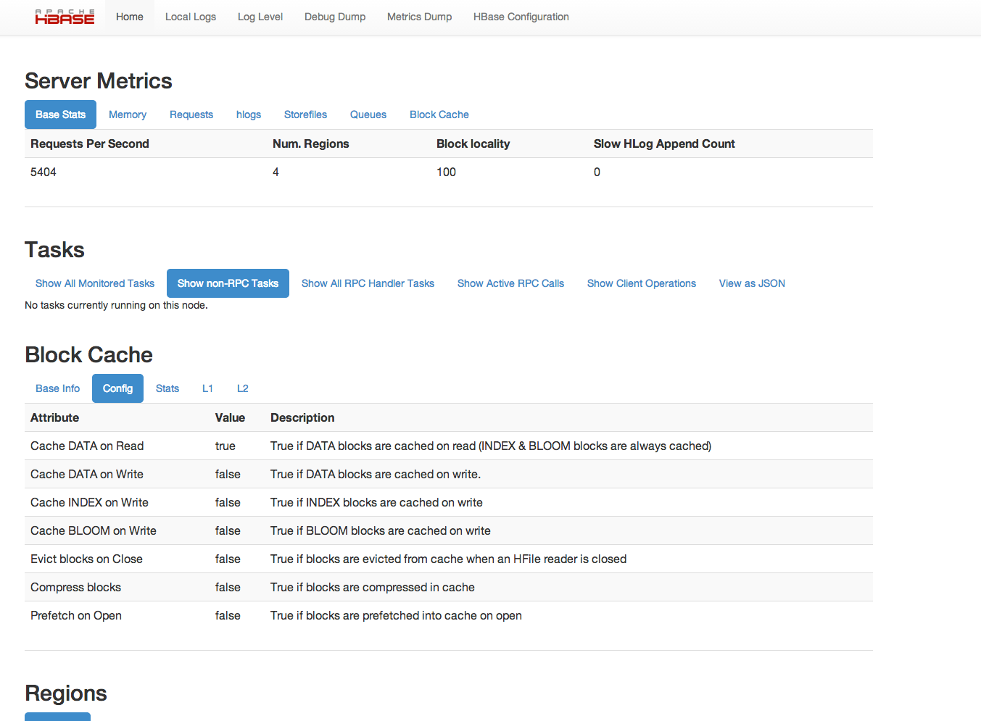
Web UI

Slide 46
PART5
Use Case

Slide 47
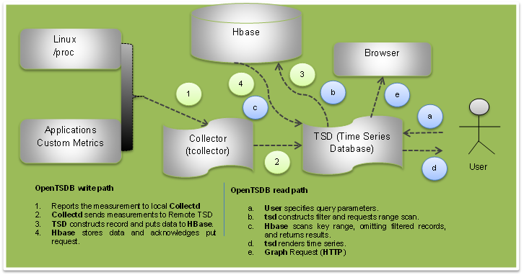
Use Case

Slide 48
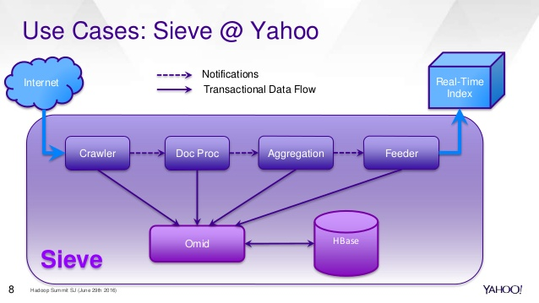
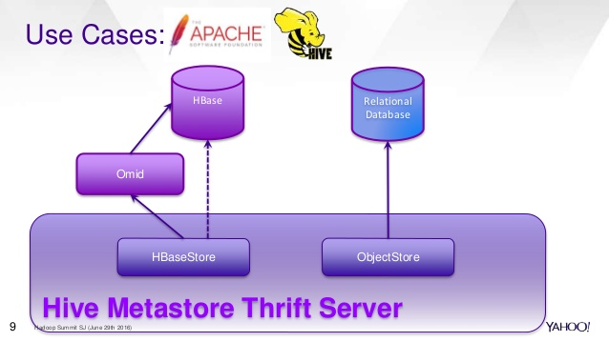
Use Case

Slide 49
PART6
Quick Start

Slide 50
Quick Start

Slide 51
Quick Start
hbase(main):0xx:0>status
hbase(main):0xx:0>version
hbase(main):0xx:0>create 'member','member_id','address','info'
hbase(main):0xx:0>list
hbase(main):0xx:0>describe 'member‘
https://hbase.apache.org/book.html

Slide 52
PART7
Reference Books

Slide 53


Books

Slide 54
The End

